Slide 1
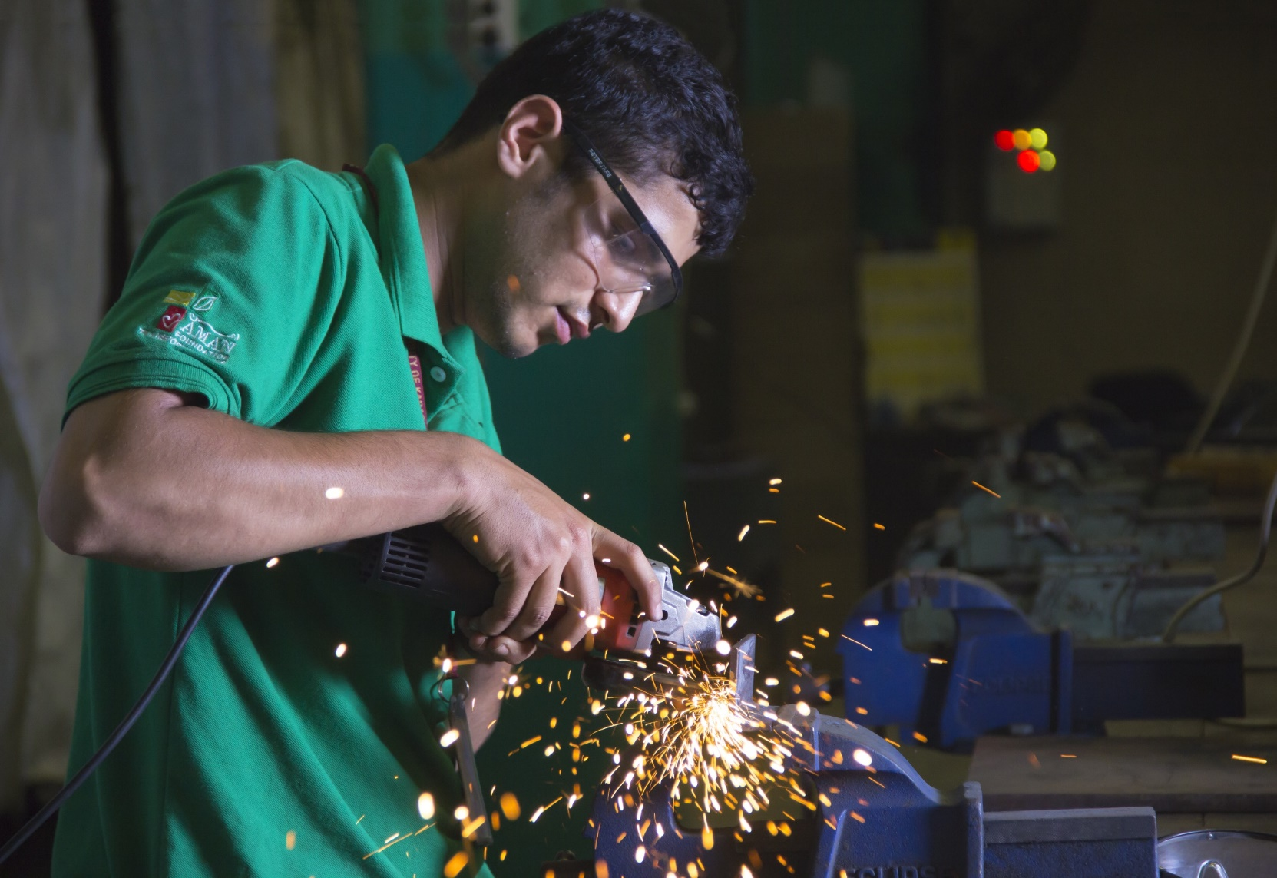
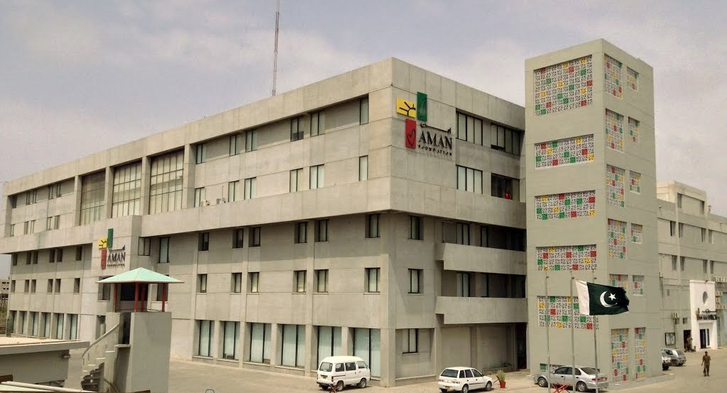
New Directions in Civic Philanthropy ….Lessons From Aman Foundation Ahmad Jalal

Slide 2
Charity vs. Institutionalized Philanthropy
Charity
Institutionalized Philanthropy
Short term relief without sustainability. Personalized and Donor Dependent
Long-term/strategic with sustainability.
Building systems and capacity
“Transactional Change”
“Transformational Change”
Money “Out of the Door”
Efficiency and Impact Returns
Beneficiary
Client / Consumer
Donor
Social Investor
Single project use of funds
Leverage/Re-cycle same funds on multiple projects
Difference in terminology but a fundamentally different approach

Slide 3
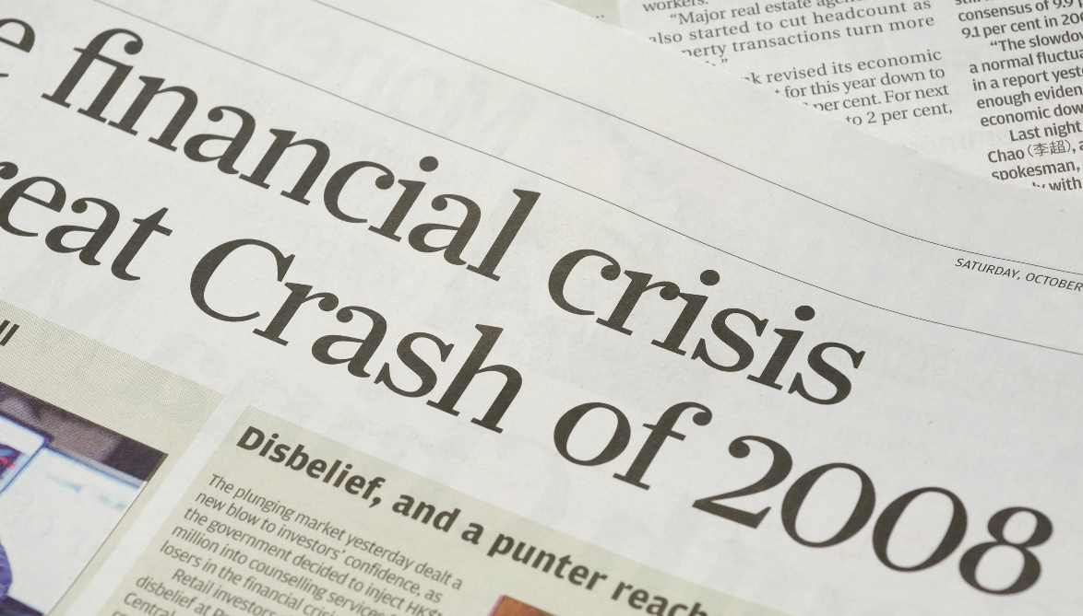
The Financial Tremor on September 16, 2008

Slide 4
Commercial Success is Not Enough, Social Mission is Critical
Think holistically…. The objectives of private and social sectors converge – there is just a difference in language
Private Sector
Social/Public Sector
Profit
Tax
Welfare
Surplus wealth is a sacred trust which its possessor is bound to administer in his lifetime for the good of the community – Andrew Carnegie

Slide 5
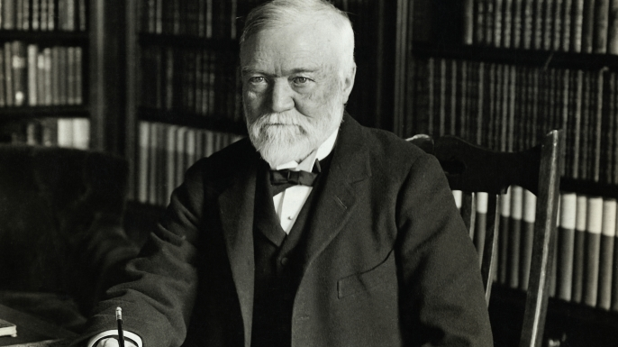
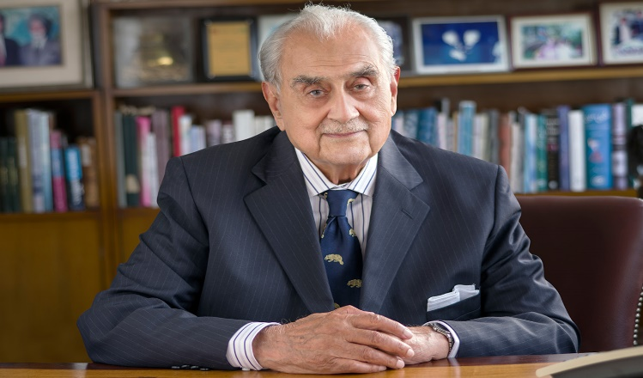
How do Countries Grow and Progress?
Betting on individuals who display Positive Deviance = Entrepreneur
Is it the individuals like the Entrepreneurs of the Pakistan Fast Growth 100 who break from the norm and create wealth and solutions for their communities

Slide 6
Social Entrepreneurship: Using Business Principles to solve a Social Problems
Social Entrepreneurship
Pursuit of long-term sustainable social impact
An effort by a committed individual or an organization
Providing self-sufficient and viable solutions to problems
Social Entrepreneurship in Pakistan is evolving…
From the idea of “helping others” by charity…. Into a broader social-cum-entrepreneurial concept

Slide 7
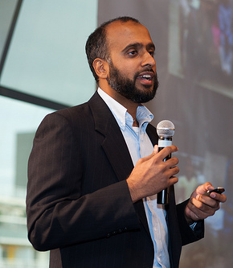
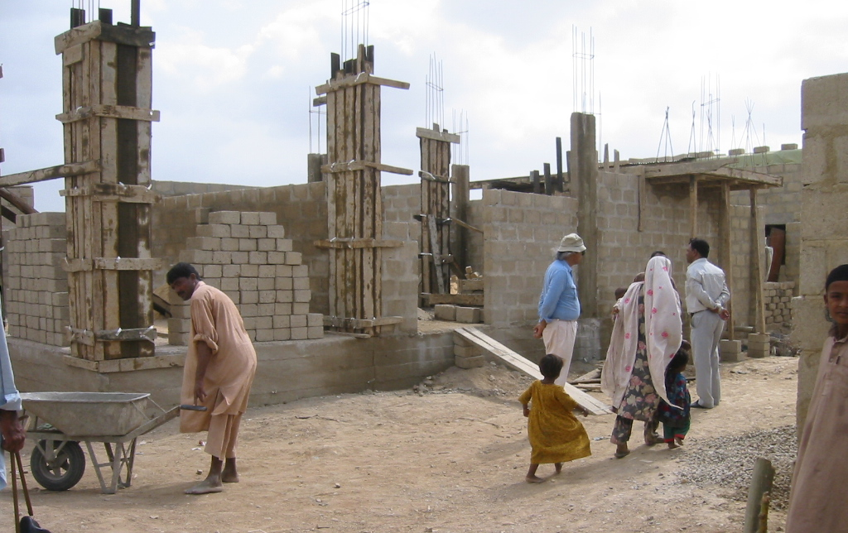
An Example from Pakistan
Ansaar Management Co.
One of the first socially driven private sector business developing and implementing affordable housing solutions for ordinary, hardworking people

Slide 8
The question arises..
Enterprise Approach
Cost consciousness
Social Objective
KPI based performance measurement (MLE)
How to Achieve
Social Impact, and
Sustainability
at Scale?
Defining and delivering core value proposition
Cover portion of costs by generating revenues
Talent Development and Management

Slide 9
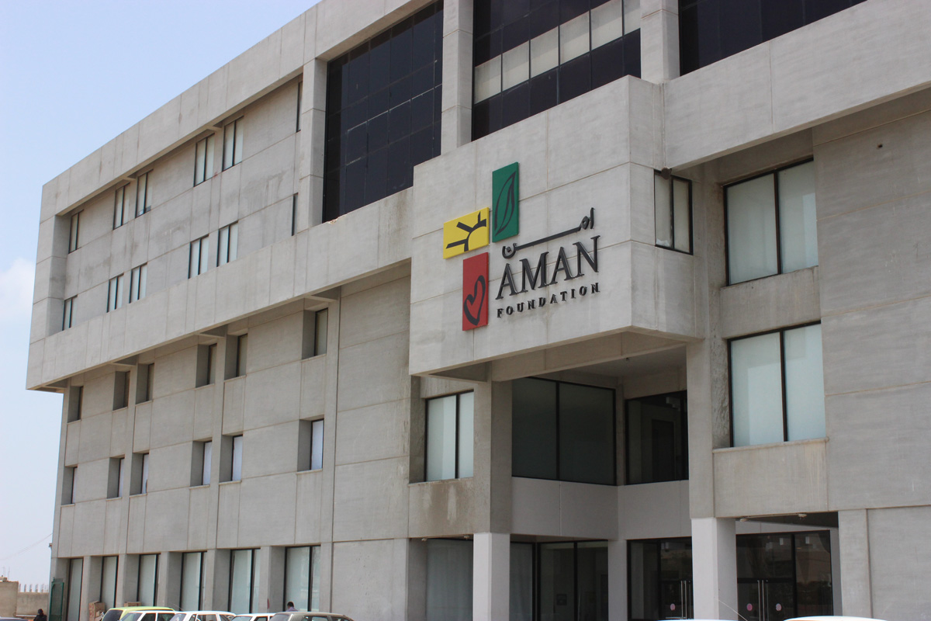
Aman Foundation
Striving to create sustainable and scalable impact by providing the basic rights of health and education to the underserved

Slide 10
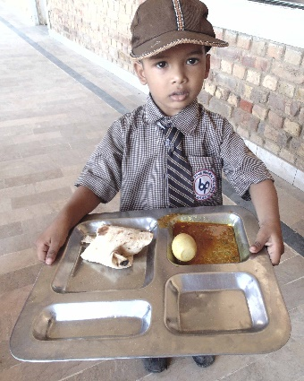
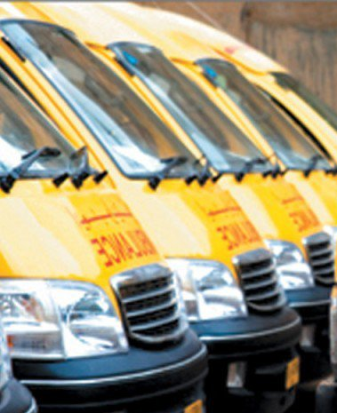
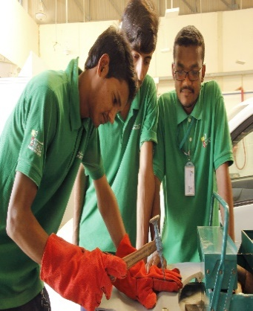
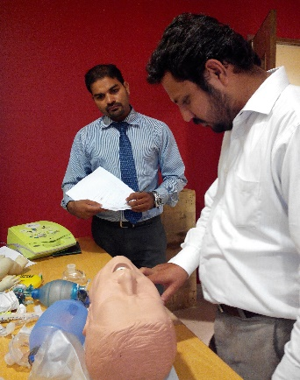
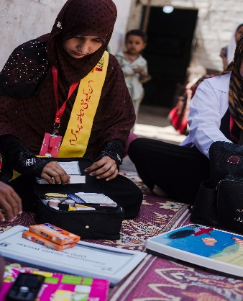
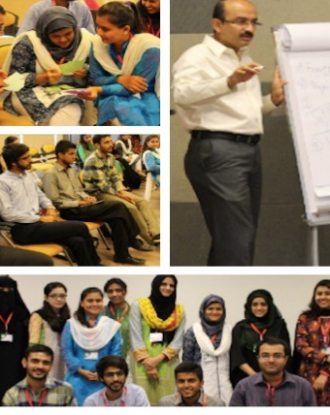
Aman’s Journey
2007
2008
2009
2011
AmanGhar Meal Plan Program Initiated
Arif and Fayeeza Naqvi establish the Aman Foundation
Launched EMS with 10 ambulances
Aman Institute of Vocational Training launched
2012
2012-13
2015
2017
Official launch of UHI & Telehealth
Inception of the Aman Community Health Program and SUKH Initiative
Launch of the
AmanLeaders MT Program
Launch of Women’s Economic Empowerment Program Subh-e-Kiran

Slide 11
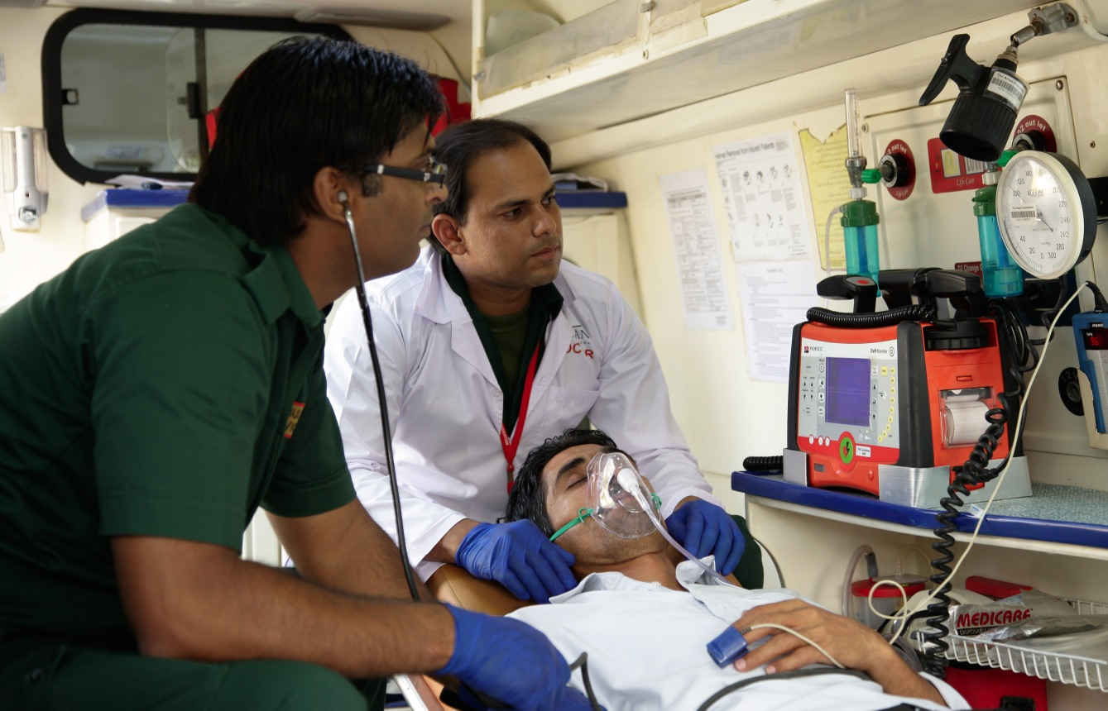
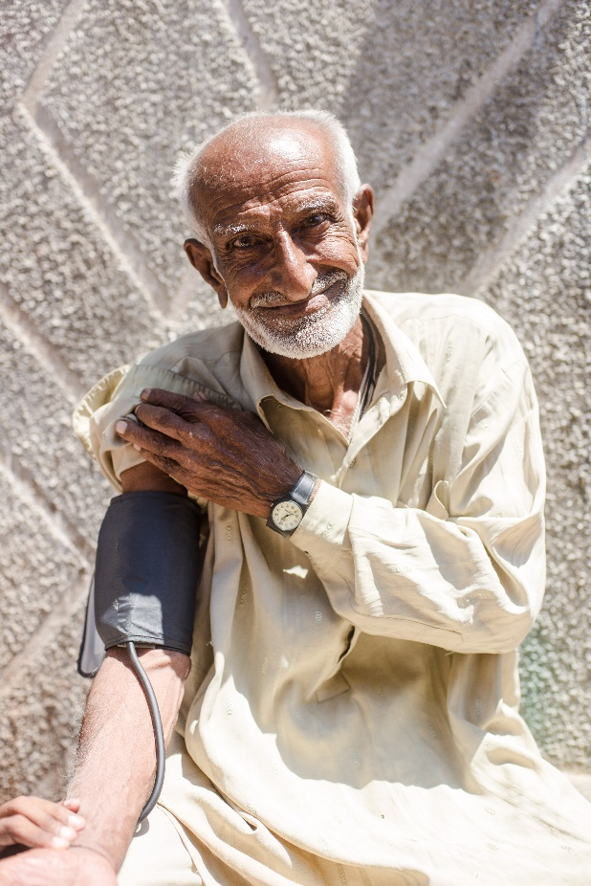
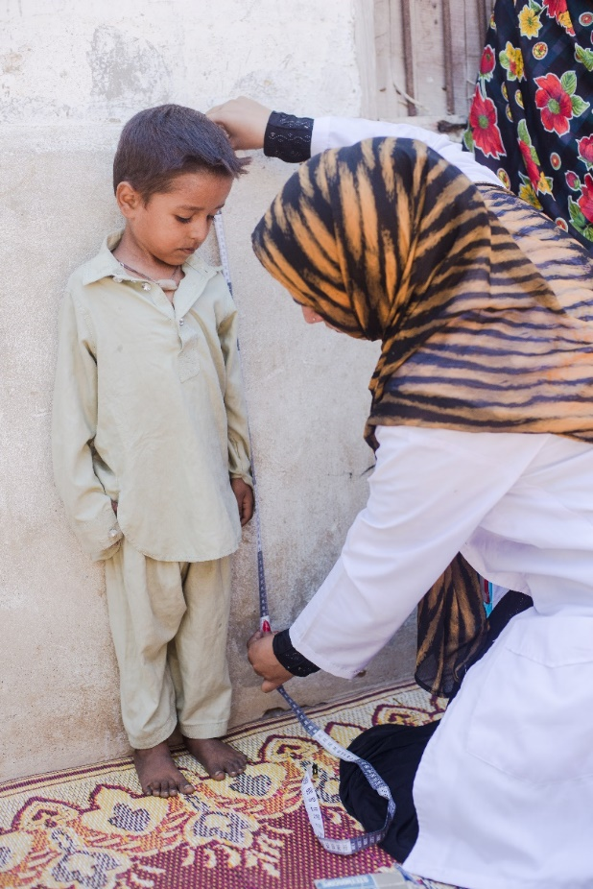
Creating a healthcare eco-system with outreach initiatives targeted towards essential preventative healthcare services
Emergency Medical Services
Community Health
Family Planning Initiative
950k+
Interventions to date
520k+
Interventions to date
Beneficiaries served by SUKH
1m
Key points across Karachi
People covered by ACHP
250
94
120k
Trained Community Health Workers

Slide 12
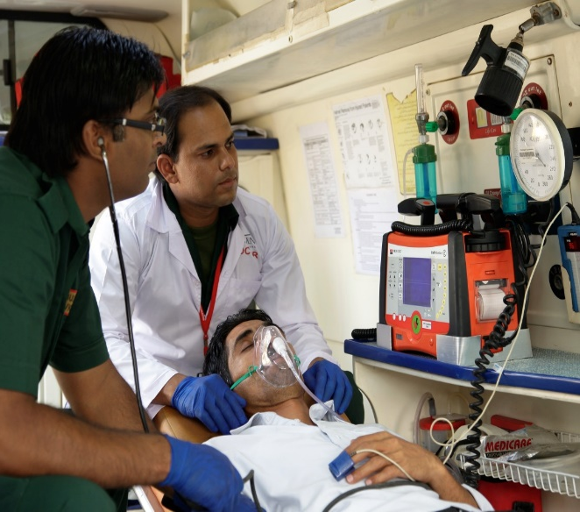
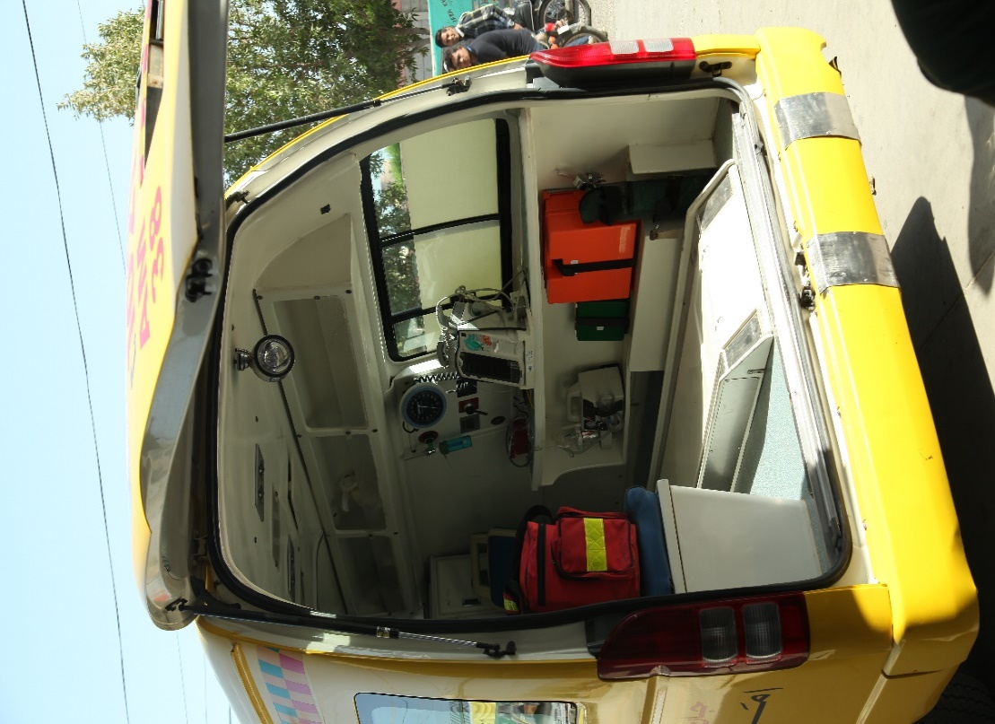
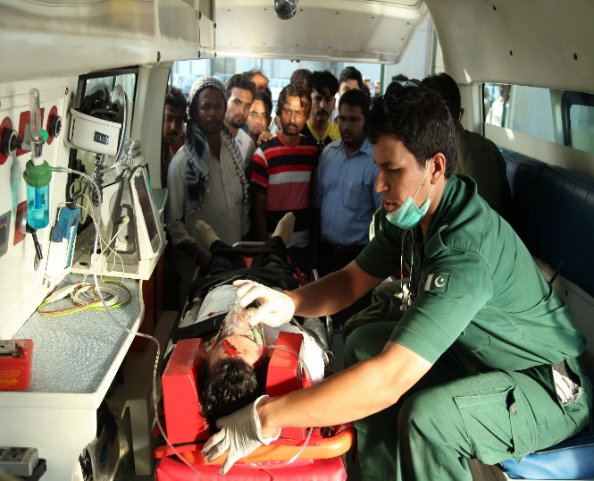
Emergency Medical Service
Aman Ambulance is run on international protocols, equipped with the latest medical equipment and life-saving drugs and staffed with trained medical professionals.
950k+
110k+
Interventions to date
Interventions last year
94
60
Key points across Karachi
Ambulances
12
6
Minutes critical
response time
Stations
There are 3 different types of ambulances: ALS, BLS and ACLS. They are ISO certified and run on international protocols
Notes:
AMANAMBULANCE, Pakistan’s first state-of the-art ambulatory network was set up and continues to run on international protocols, comprising 80 ambulances with doctors, advanced paramedics and life-saving drugs and equipment on board providing 24/7 emergency medical interventions

Slide 13
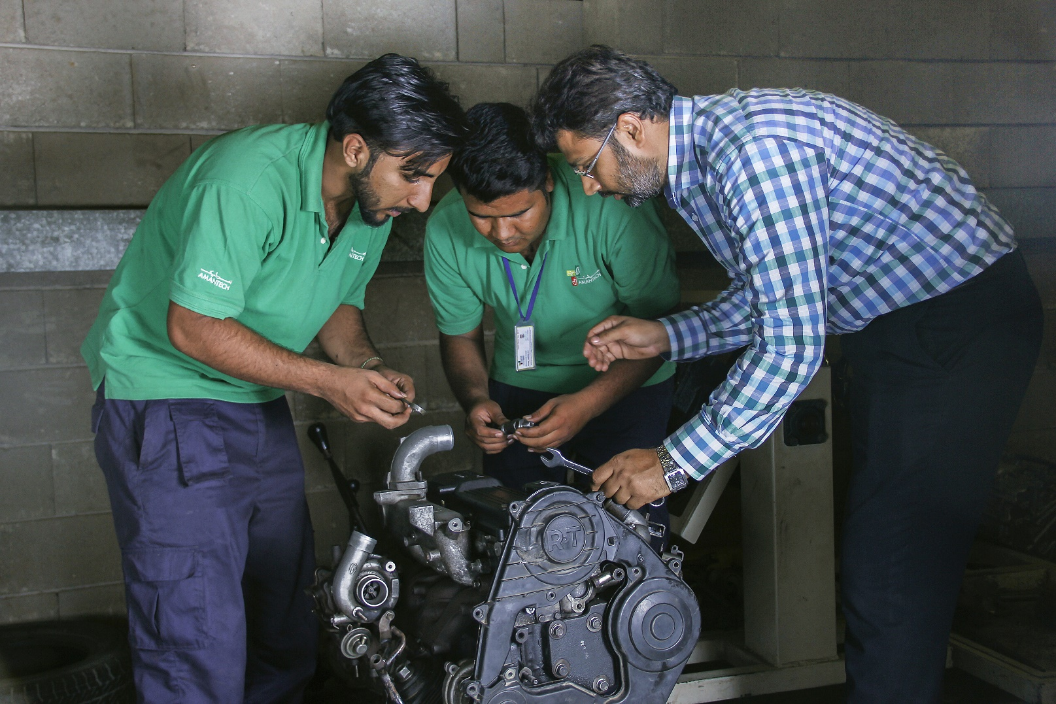
A state-of-the-art vocational training institute that aims to build a sustainable future for the youth of Karachi
A state of the art institute that aims to:
economically and socially empower the at-risk youth of Pakistan
provide avenues to enhance their skills and prospects of employability
specially focus on soft skills, discipline, personality grooming, and civic sense
Our instructors work to build confidence, promote team-work, and instill tolerance for religious and ethnic diversity – all with the objective of producing not just exceptional employees, but exceptional citizens
10,236
1,600
Graduates
Active students
12
69%
Trades offered
Placement rate

Slide 14
Teaching at AmanTech at a Glance
Technical Education – Trades Offered
Soft Skills
Practical Skills 80%
Basic communication, English language and presentation skills
Theoretical Skills 20%
Mechanical
Refrigeration & Air Conditioning
Electrical/Electronics
Automobile
Fabrication Welding & Pipework
CAD CAM
CAD Civil
Auto Body Repair Technician
Auto Paint Repair Technician
Mechatronics
Stitching Machinist (females only)
Offset Printing
Basic computer literacy
Personality and character building, with career counselling
Mind mapping, stress management and time management
Basic etiquettes, personal hygiene and grooming

Slide 15
Industry Alignment
Our graduates are employed locally as well as internationally
Graduates placed
Top Local Employers
4,960
Locally placed
207
Internationally placed
Employers
Top International Employers
2k+
Local
50+
International

Slide 16
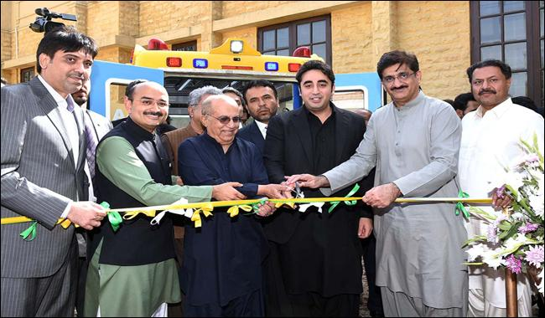
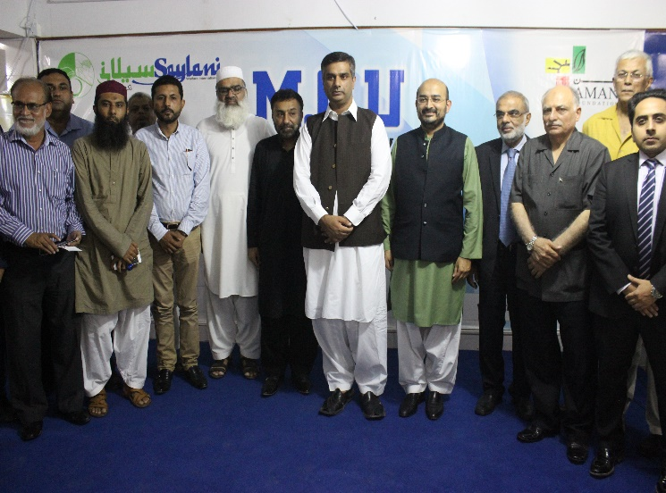
Exponential Social Impact Post-Partnerships
Scale through Partnerships
Achieve Operational Excellence
Seeded Operational Blueprints to Scale
Phase 3
Phase 2
Phase 1
Expansion of Aman Ambulances through Sindh People’s Ambulance Service (SPAS)
Thatta & Sajawal, March 2017
Aman Ghar partners with
Saylani Welfare for School Meal Program, September 2017
1,500
160+
1,000
Number of meals per day within 3 months
Total number of interventions per month
Number of clinical staff trained

Slide 17
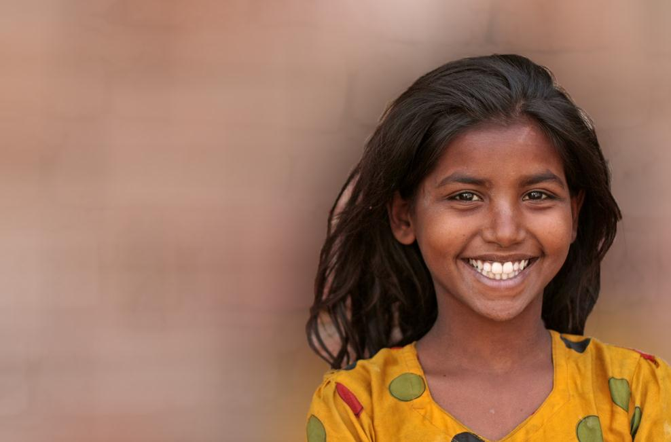
Thank You
Ahmad.Jalal@amanfoundation.org

